Slide 1

9. Radiation & Antennas
7e Applied EM by Ulaby and Ravaioli

Slide 2
Overview

Slide 3
Radiation
What is radiation?
Radiant energy released by certain electromagnetic processes
Classical theory: electromagnetic radiation consists of electromagnetic waves
Quantum theory: electromagnetic radiation consists of photons
Source of radiation: accelerated charged particles

Slide 4
Fields of Moving Charges
A good resource
http://phet.colorado.edu/sims/radiating-charge/radiating-charge_en.html
A static charge produces static electric field at the speed of light
When a charge is moving, the generated electric fields change accordingly
When the charge moves with acceleration, the generated electric fields exhibit oscillating natures, which will in turn generate magnetic fields and form electromagnetic fields

Slide 5
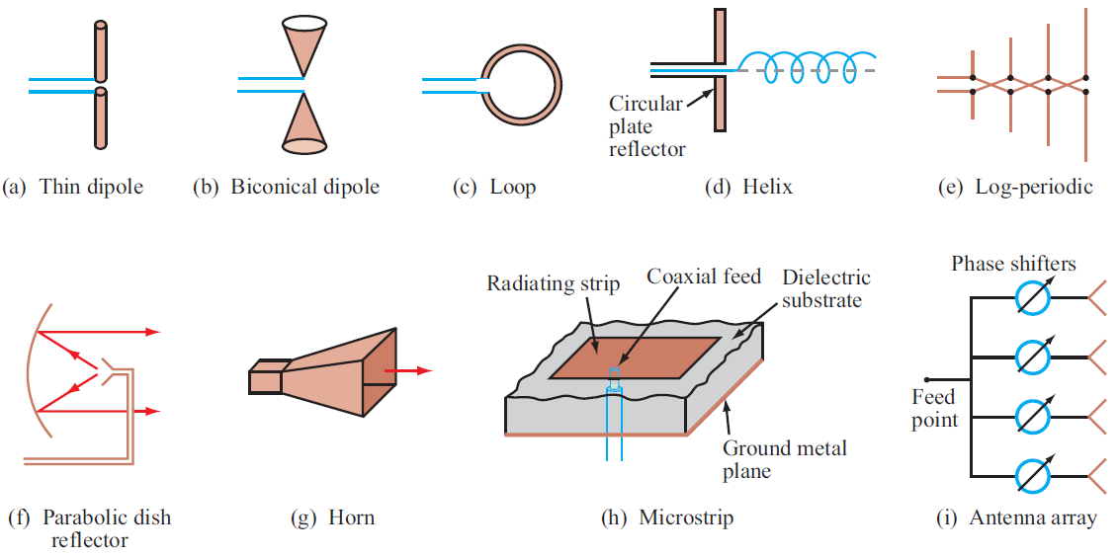
Examples of Antennas

Slide 6
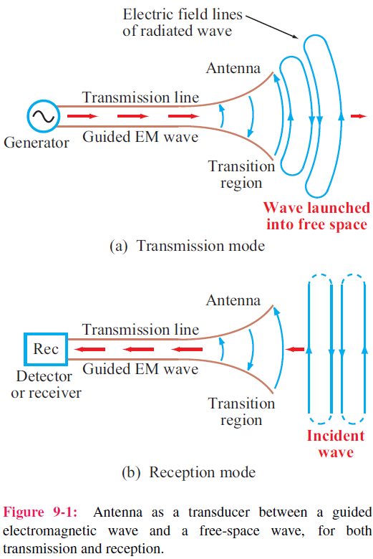
Antenna Properties
1. An antenna is a transducer that converts a guided wave propagating on a transmission line into an electromagnetic wave propagating in an unbounded medium (usually free space), or vice versa.
2. Most antennas are reciprocal devices, exhibiting the same radiation pattern for transmission as for reception.
3. Being a reciprocal device, an antenna, when operating in the receiving mode, can extract from an incident wave only
that component of the wave whose electric field matches the antenna polarization state.

Slide 7
Analogy to Capacitor
Use the analogy between a capacitor and an antenna to give an intuitive explanation of radiation
This analogy is based on the fact that the electric fields generates displacement currents that together with the conduction currents form a closed loop of the circuit
Capacitor
Antenna
V
E

Slide 8
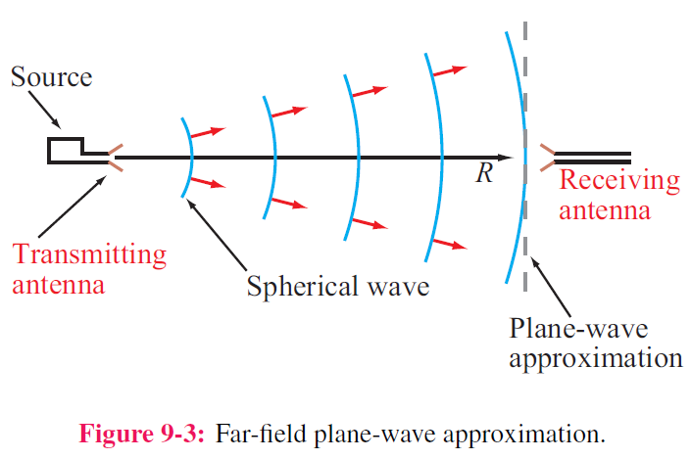
Far-Field Approximation
1. In close proximity to a radiating source, the wave is spherical in shape, but at a far distance, it becomes approximately a plane wave as seen by a receiving antenna.
2. The far-field approximation simplifies the math.
3. The distance beyond which the far-field approximation is valid is called the far-field range (will be defined later).

Slide 9
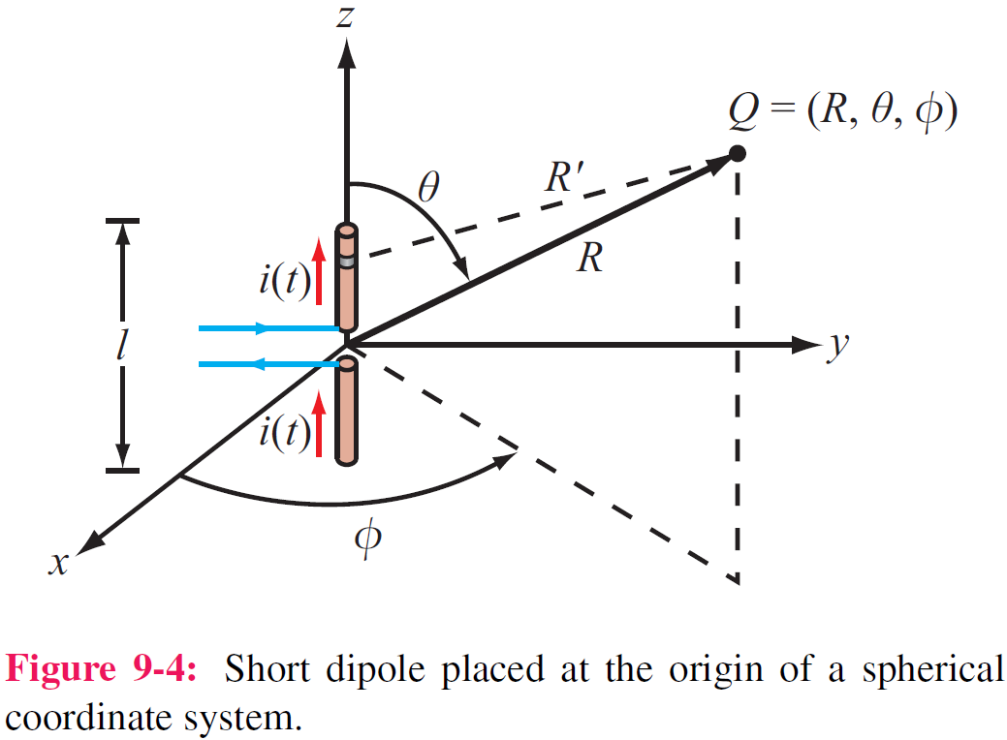
The Hertzian Dipole
A Hertzian dipole is a thin, linear conductor whose length l is very short compared with the wavelength λ; l should not exceed λ/50.
This restriction allows us to treat the current along the length of the conductor as constant, even though it has to decay to zero at the ends of the wire.
The field of the entire antenna may be obtained by integrating
the fields from all these differential antennas, with the proper
magnitudes and phases taken into account

Slide 10
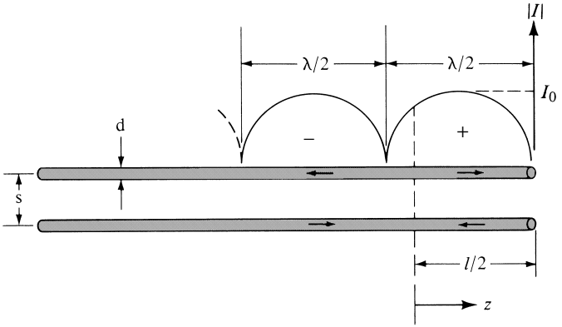
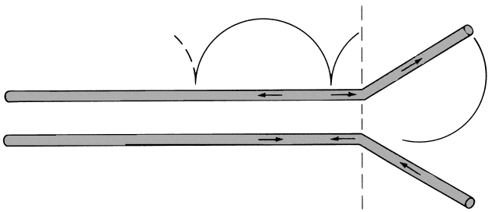
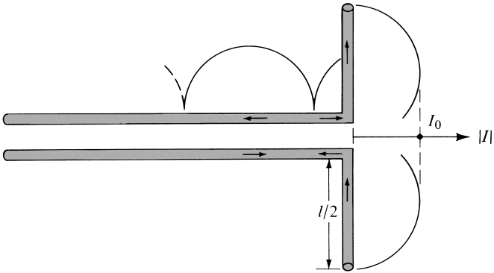
Current Distribution on Wires
The wave traveling between the wires undergoes a total reflection at the end of the wire and forms standing wave on the wires
The current at the end of the wires are always zero

Slide 11
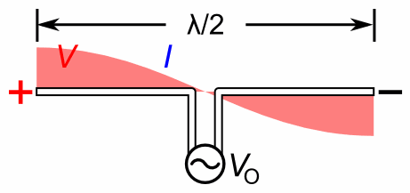
Current and Voltage Distribution

Slide 12
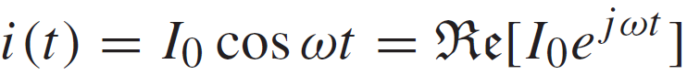
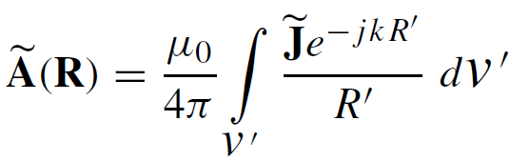
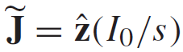
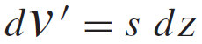
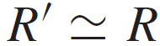
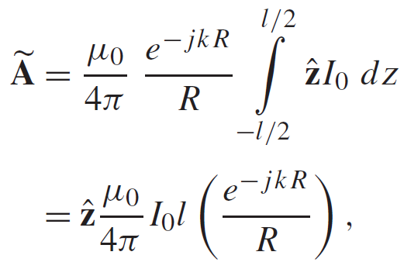
Fields Radiated by Hertzian Dipole
Current along dipole:
See p. 259, 303
Magnetic Vector Potential:
With:
Given A, we can determine E and H

Slide 13
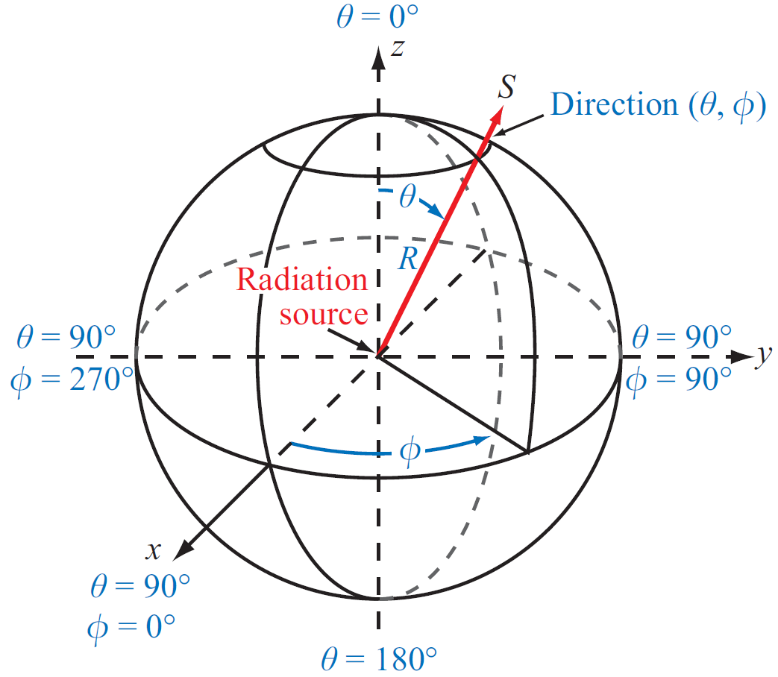
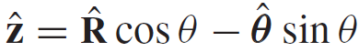
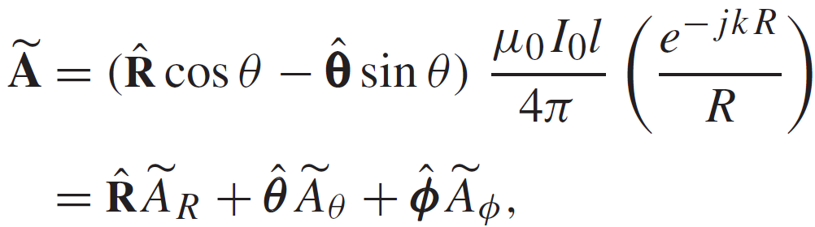
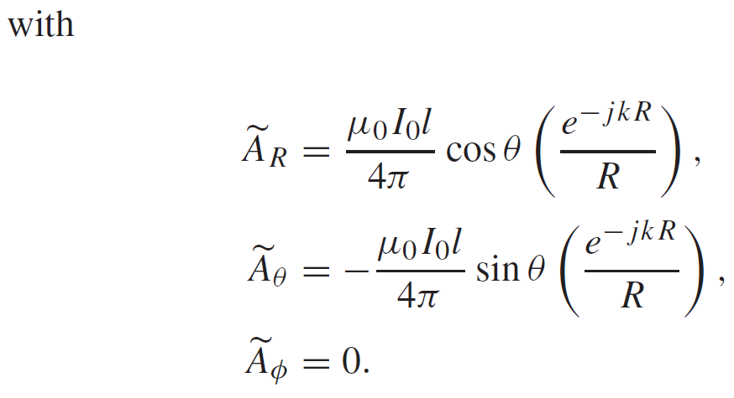
Fields Radiated by Hertzian Dipole (cont.)
Upon converting z to spherical coordinates:
We have:

Slide 14
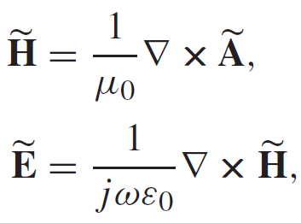
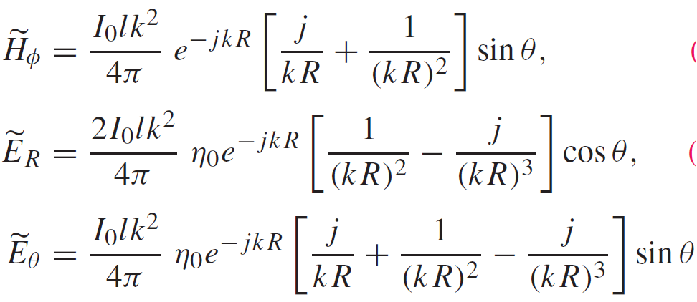
Fields Radiated by Hertzian Dipole (cont.)
Application of:
leads to:

Slide 15
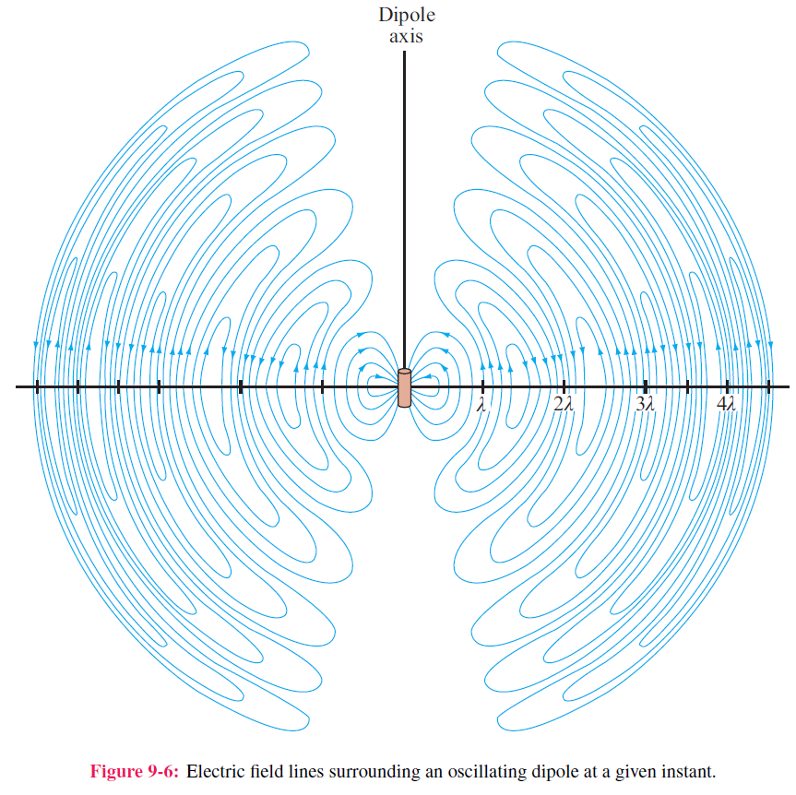
Radiated Electric Field

Slide 16
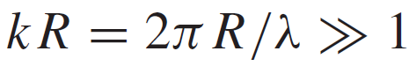
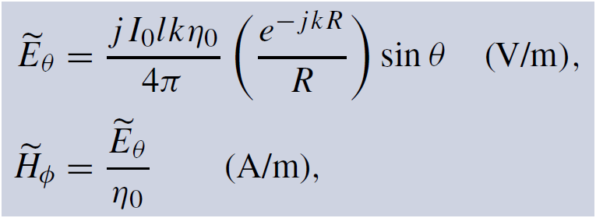
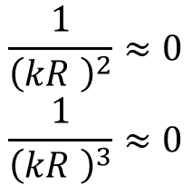
Hertzian Dipole—Far-Field Approximation
At any range R:
$$\frac{1}{{\left(kR \right)}^{2}}≈0$$
$$\frac{1}{{\left(kR \right)}^{3}}≈0$$
At

Slide 17
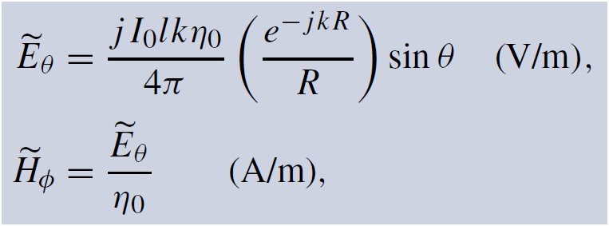
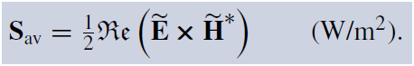
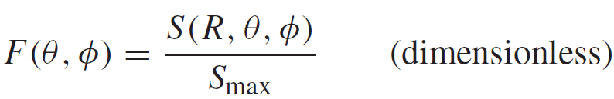
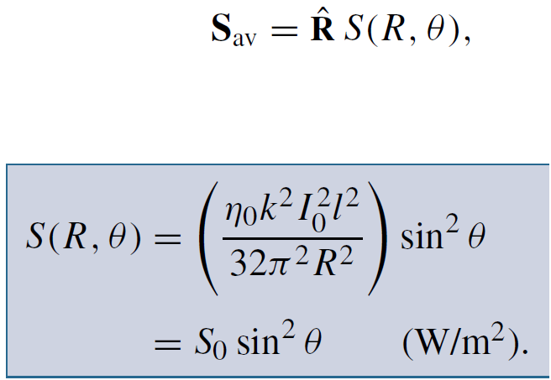
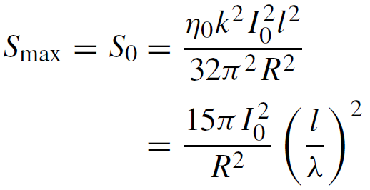
Normalized Radiation Intensity
Electric and Magnetic Fields
Normalized Radiation Intensity
Average Power Density
W/m²

Slide 18
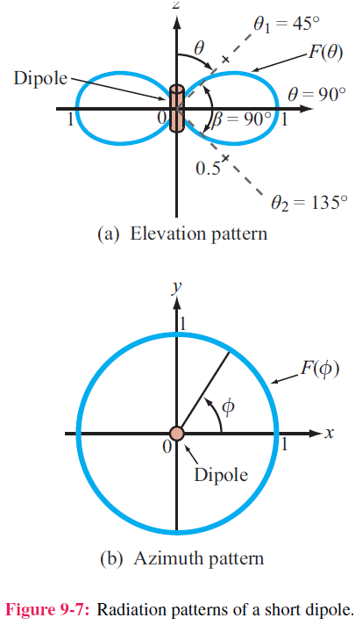
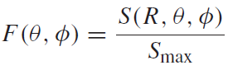
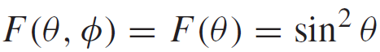
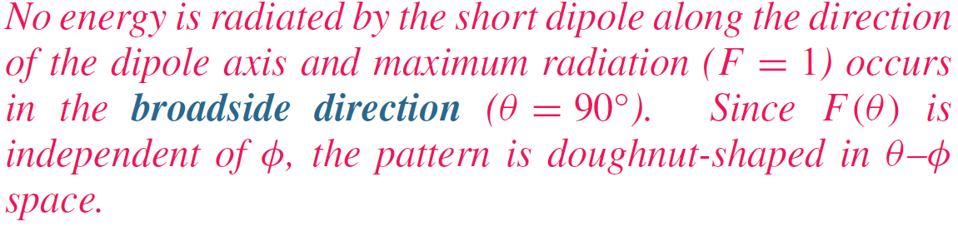
Radiation Pattern of Hertzian Dipole

Slide 19
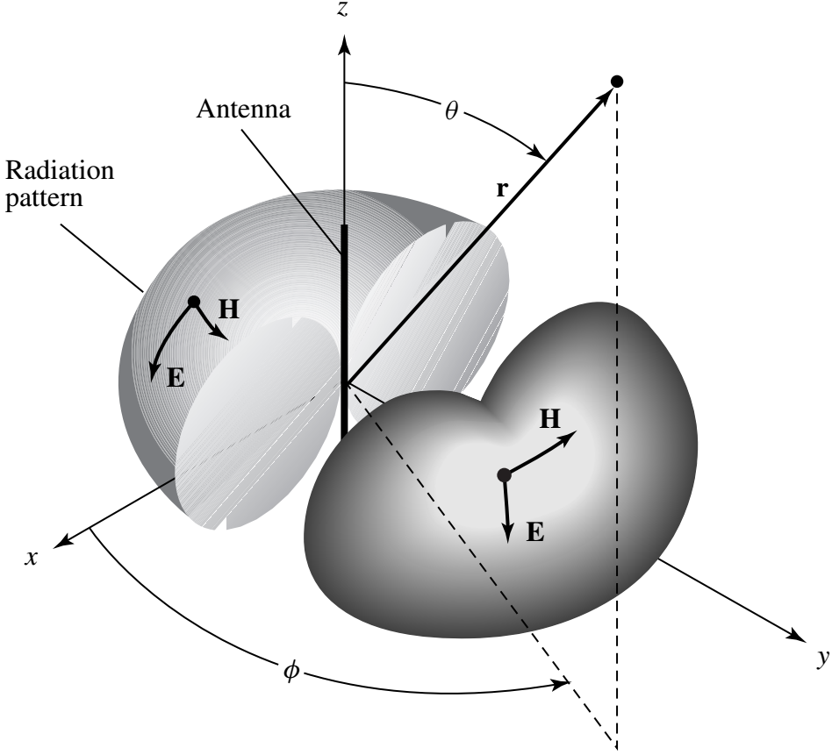
3D Radiation Pattern of A Dipole

Slide 20
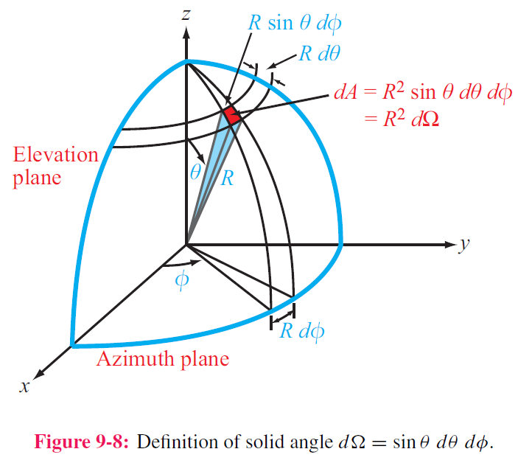
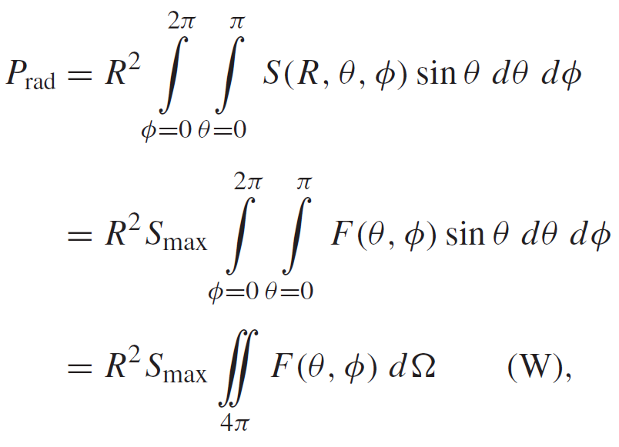
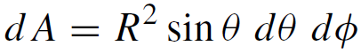
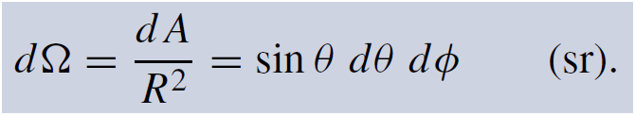
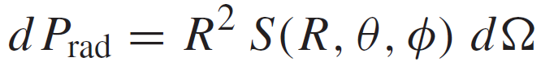
Antenna Radiation Characteristics
1. By virtue of reciprocity, a receiving antenna has the same directional antenna pattern as the pattern that it exhibits when operated in the transmission mode.
2. Total Radiated Power
Differential area
Total Radiated Power
Solid Angle
Power radiated through dA

Slide 21
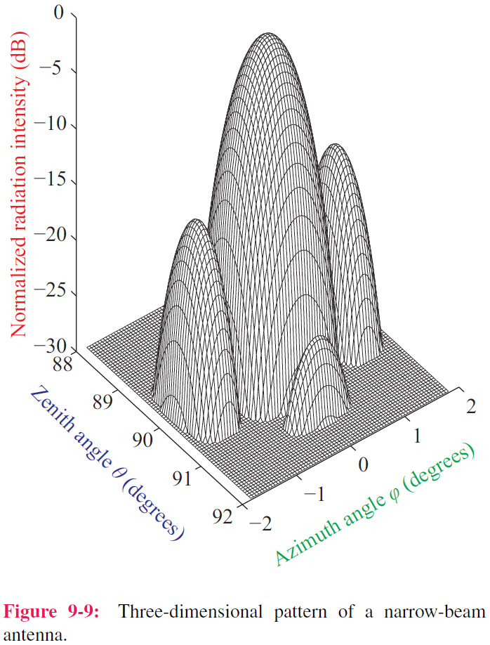
Example of 3-D Pattern
F (dB) = 10 log F
Principal planes:
1. Elevation plane (x-z and y-z planes)
2. Azimuth plane (x-y plane)

Slide 22
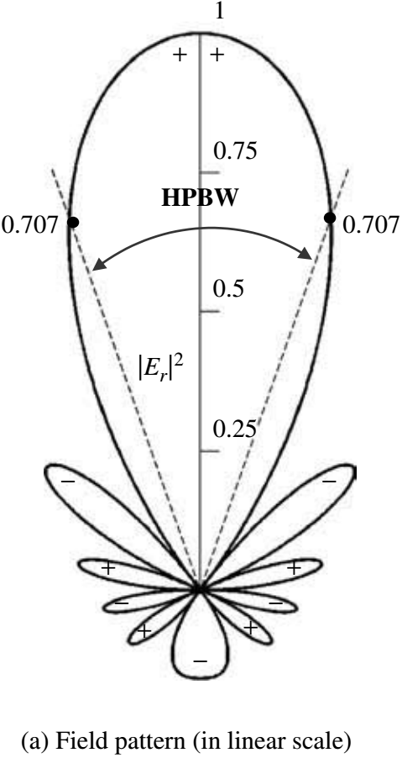
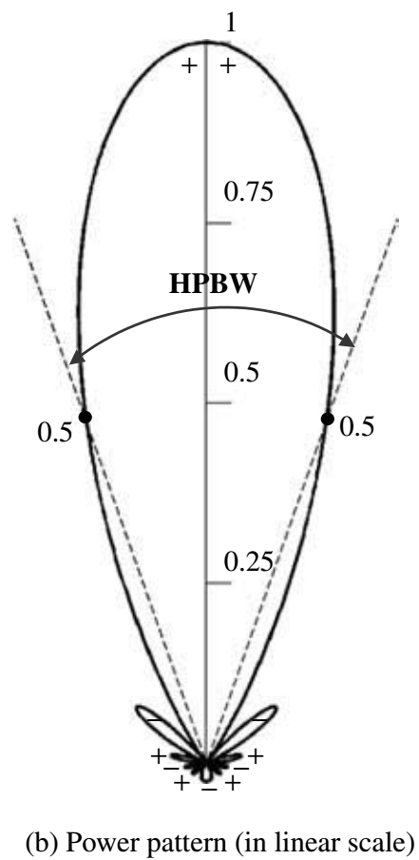
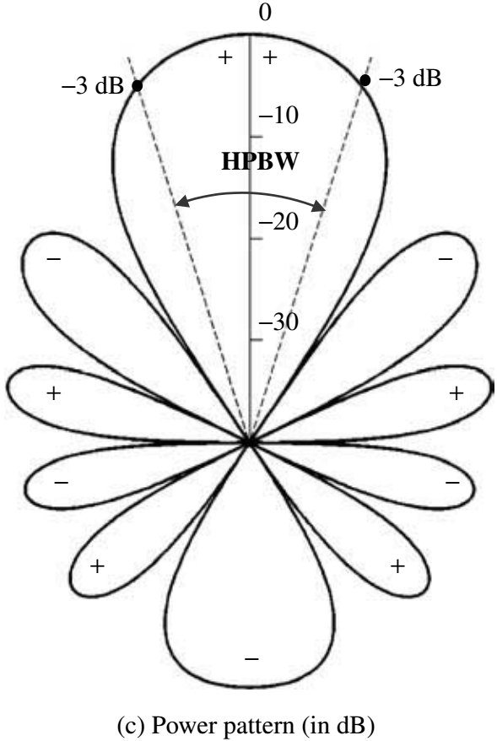
Different Pattern in Different Scale

Slide 23
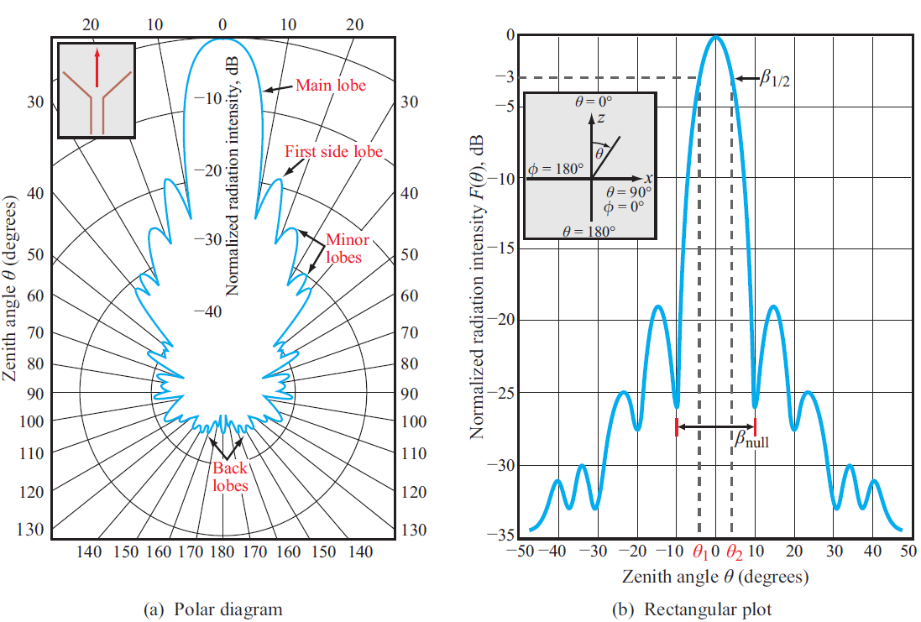
Polar and Rectangular Plots

Slide 24
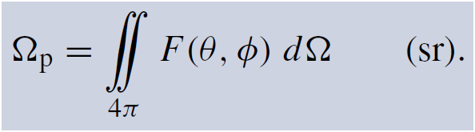
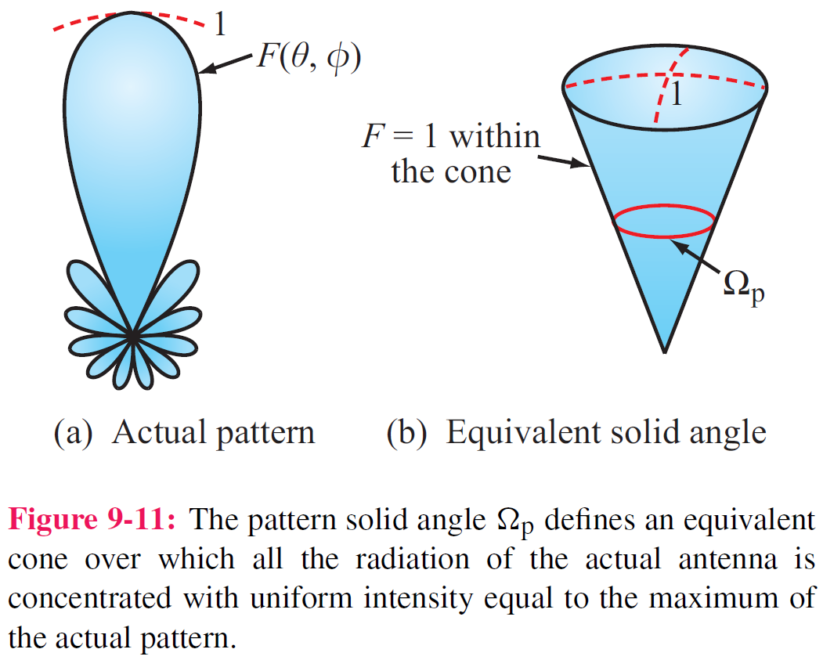
Pattern Solid Angle
steradian
Equivalent Solid Angle
See p. 412

Slide 25
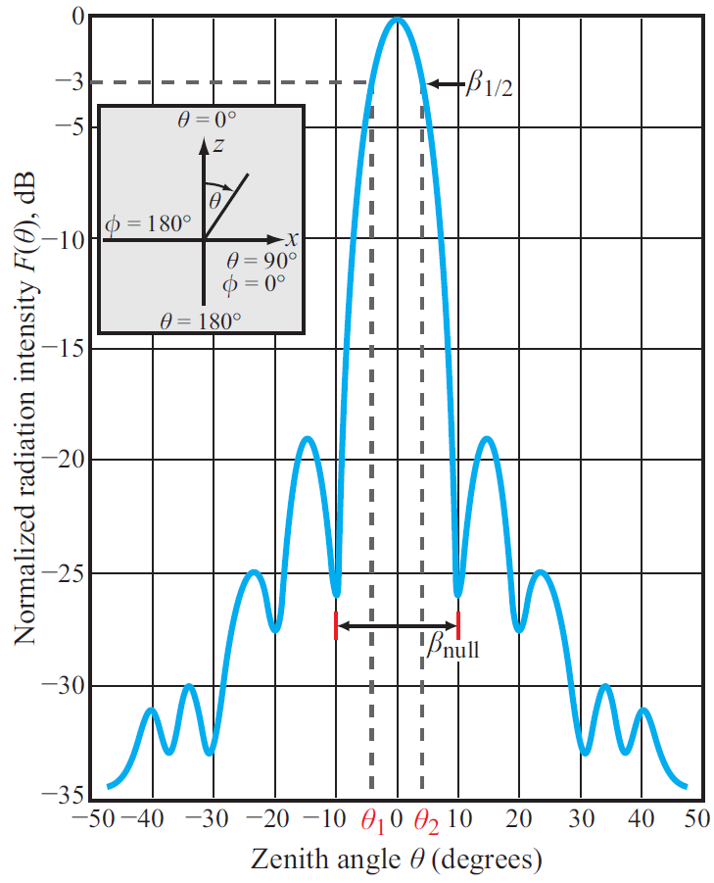
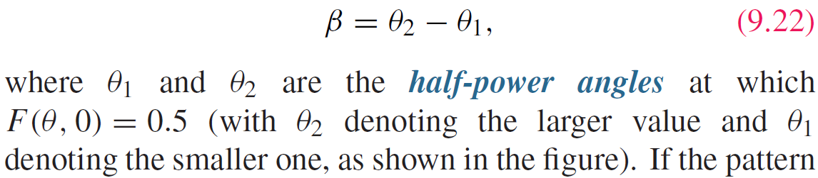
Beam Width
Half-power beamwidth
Since 0.5 corresponds to ‒3 dB, the half power beamwidth is also called the 3-dB beamwidth.

Slide 26
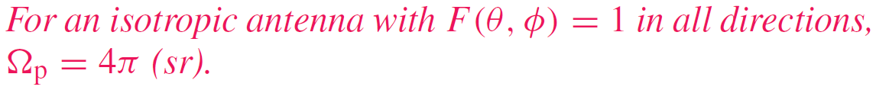
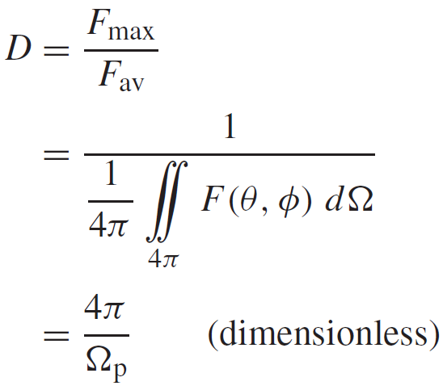




Antenna Directivity D
Antenna pattern solid angle
Maximum normalized radiation intensity = 1
Directivity
Average value of F(θ,φ) over all directions
$$\iint_{4π}{F\left(θ,φ\right)dΩ}=\frac{P_{rad}}{R^{2}S_{max}}$$
$$D≥1$$
$$D=\frac{4πR^{2}S_{max}}{P_{rad}}=\frac{S_{max}}{S_{av}}$$

Slide 27



Cont.

Slide 28


(cont.)

Slide 29


Slide 30


Radiation Efficiency and Gain
Radiation efficiency
Radiation efficiency does not consider impedance mismatch
Antenna gain G

Slide 31




Antenna Radiation and Loss Resistances
Antenna is merely a load with input impedance Z_{in}
$$Z_{in}=R_{in}+jX_{in}$$
$$P_{t}=\frac{1}{2}I_{0}^{2}R_{in}$$

Slide 32

Cont.

Slide 33



Example 9-3 (cont.)
For any antenna:
For the Hertzian dipole:

Slide 34






Half-Wave Dipole
1. Current in half-wave dipole
2. For Hertzian dipole of length l, E field is:
3. Each length element dz of half-wave dipole is like a Hertzian dipole, radiating a field
4. For the entire dipole, the total radiated field is
See p. 418

Slide 35



Half-Wave Dipole (cont.)
Integration leads to:

Slide 36


Radiation Pattern of Half-Wave Dipole
Radiation pattern resembles that of the Hertzian dipole. Its beamwidth is slightly narrower, 78 degrees compared with 90 degrees for the Hertzian dipole.

Slide 37




Other Half-Wave Dipole Properties
1. Directivity
2. Radiation Resistance
Numerical integration gives:
This is very important, because it makes it easy to match the antenna to a 75-Ω transmission line. In contrast, the radiation resistance of a dipole whose length is much shorter than a wavelength is on the order of 1 Ω or less.

Slide 38

Quarter-Wave Monopole
When placed over a conducting ground plane, a quarter-wave monopole antenna excited by a source at its base [Fig.9-15(a)] exhibits the same radiation pattern in the region above the ground plane as a half-wave dipole in free
space.
However, its radiation resistance if only half of that of a half-wave dipole, namely 36.5 Ω.
Image theory

Slide 39





Dipole of Arbitrary Length

Slide 40


Radiation Pattern of Different Dipole

Slide 41




Antenna Effective Area

Slide 42


Friis Transmission Formula
See p. 427

Slide 43


Slide 44


Example 9-4 (cont.)

Slide 45

Radiation by Aperture Antennas
Instead of calculating the radiated fields E and H at Q due to currents in the antenna, with apertures it is also possible to relate the radiated fields to the electric field distribution across the aperture.

Slide 46

Examples of Aperture Sources
Computational Approaches
a. Vector Formulation--accurate, but mathematically involved
b. Scalar Formulation—easier to implement but restricted to large aperture dimensions (relative to the wavelength)
2. Both methods are applicable at all wavelengths, including the visible spectrum
3. Validity of Scalar Formulation. The key requirement for the validity of the scalar formulation is that the antenna aperture be at least several wavelengths long along each of its principal dimensions.
We will limit our treatment to the scalar formulation.

Slide 47



Relating Radiated Field to Aperture Distribution
Far Field Condition
Radiated E Field
Aperture Distribution

Slide 48





Rectangular Aperture with Uniform Distribution
Uniform distribution across aperture
Scalar formulation leads to:
The sinc function is maximum when its argument is zero; sinc(0) = 1.

Slide 49

Examples of Radiation Patterns
Circular aperture has circular beam
In each principal plane, beamwidth is inversely proportional to antenna dimension in that plane
Cylindrical reflector has narrow beam along length direction and wide beam along its width direction

Slide 50

Directivity & Effective Area

Slide 51

Antenna Arrays

Slide 52
Antenna Arrays
An antenna array to a continuous aperture is analogous to digital data to analog. By controlling the signals fed into individual array elements, the pattern can be shaped to suit the desired application.
Also, through the use of electronically controlled solid-state
phase shifters, the beam direction of the antenna array can
be steered electronically by controlling the relative phases
of the array elements.
This flexibility of the array antenna has led to numerous
applications, including electronic steering and multiple-beam
generation.

Slide 53



Array Pattern
Power density radiated by the entire array
Power density radiated by an individual element
Array Factor
The array factor represents the far-field radiation intensity of the N elements, had the elements been isotropic radiators.

Slide 54


Cont.

Slide 55



Example 9-5 (cont.)

Slide 56


Example 9-5 (cont.)

Slide 57




Array Pattern for Uniform Phase Distribution
Any array with identical elements
Array with uniform phase
Array with uniform phase and amplitude

Slide 58



Slide 59





Electronic Steering
With linear phase:
with:
Angle at which the steered pattern is a maximum

Slide 60

Examples of Steered Patterns
Note that the pattern widens as it is steered away from broadside

Slide 61


Array Feeding
The electrical lengths of the lines can be changed by changing the broadside frequency

Slide 62



Cont.

Slide 63

Example 9-8 (cont.)
Cont.

Slide 64

Example 9-8 (cont.)

Slide 65

Summary

